Slide 1


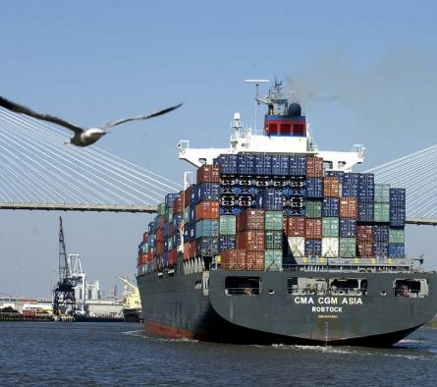


Charleston Harbor Post 45 Deepening
Feasibility Study
Barbara Melvin
Senior Vice President – External Affairs
South Carolina State Ports Authority
Lisa Metheney
Deputy District Engineer for Programs and Project Management
Charleston District
U.S. Army Corps of Engineers
13 May 2014
US Army Corps of Engineers
BUILDING STRONG®
Charleston District

Slide 2


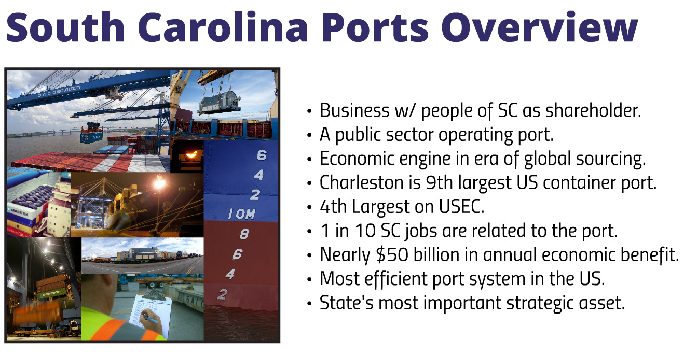

Slide 3
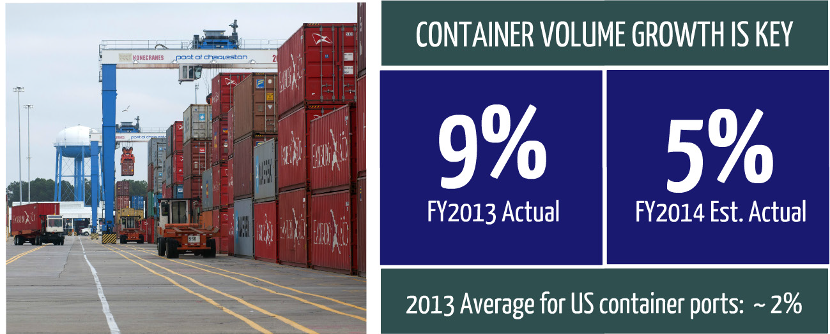

Slide 4
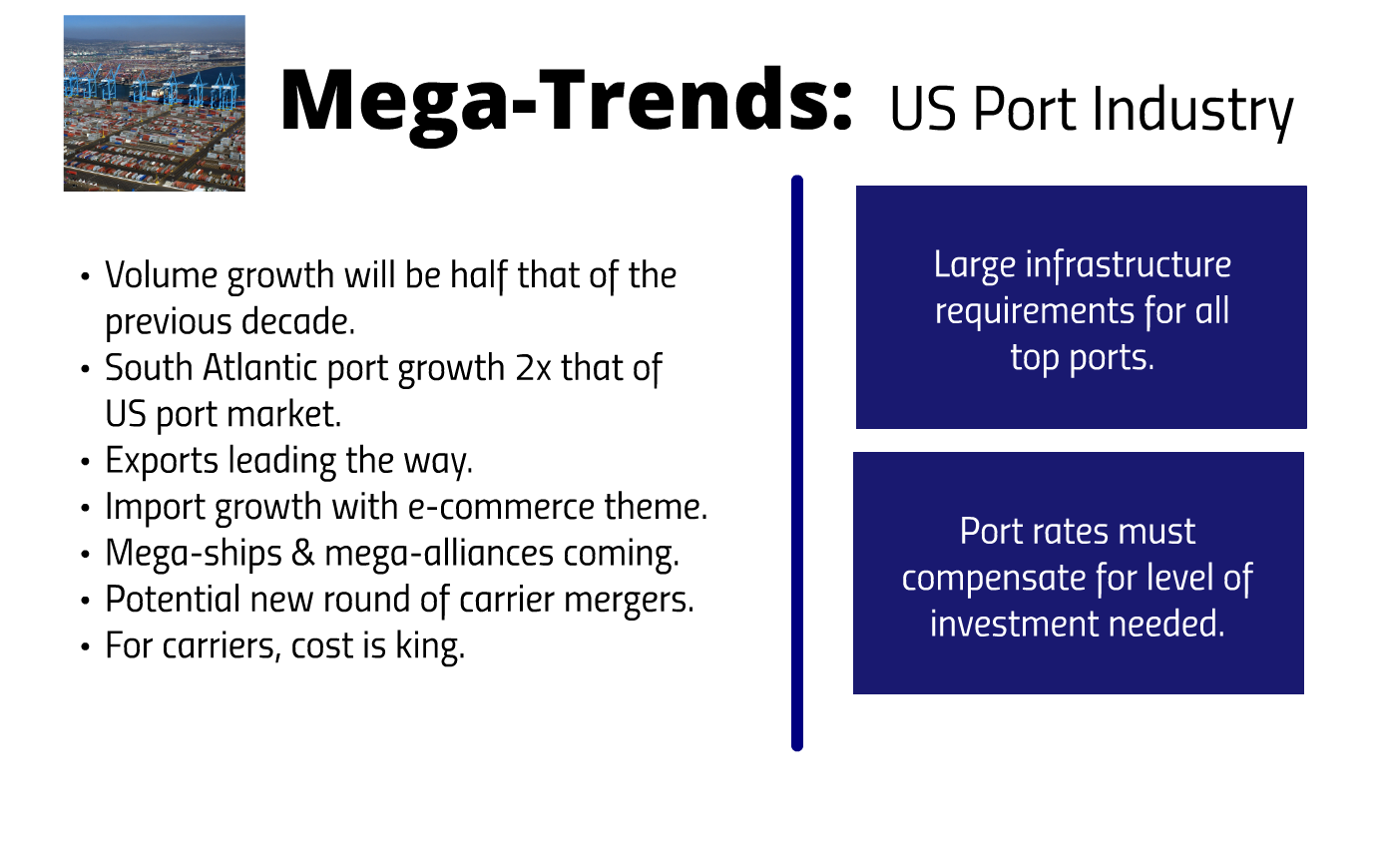

Slide 5
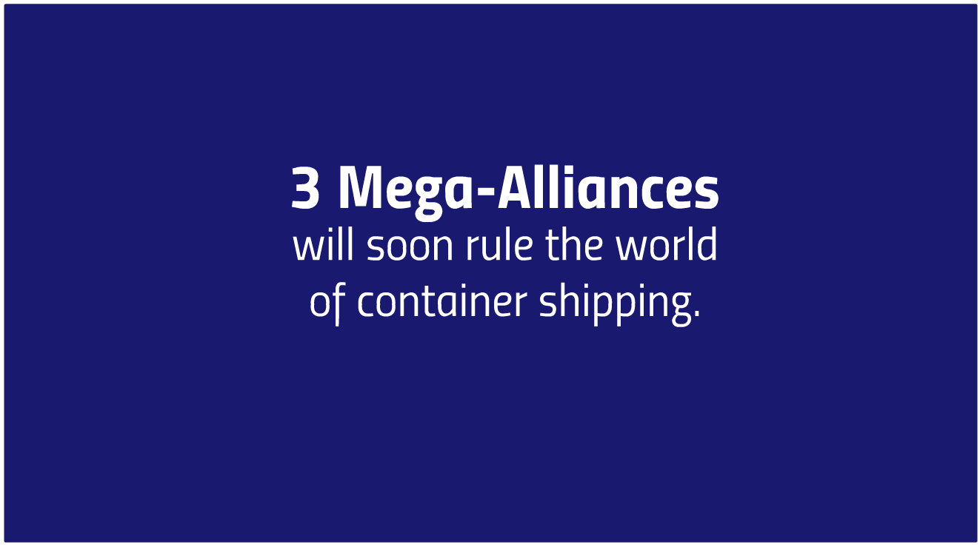

Slide 6
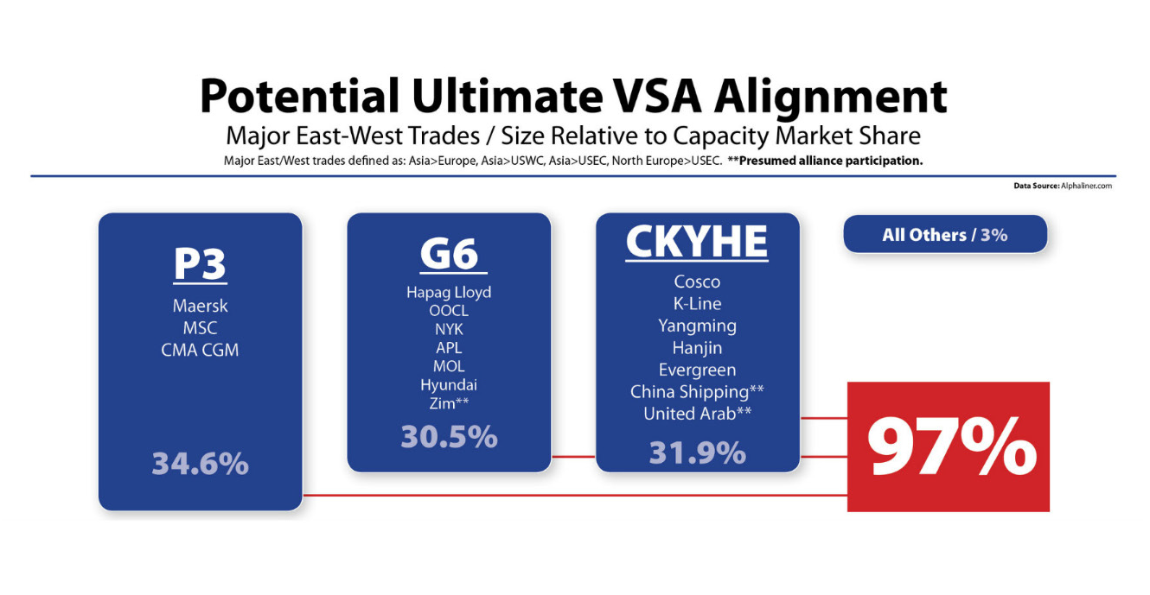

Slide 7
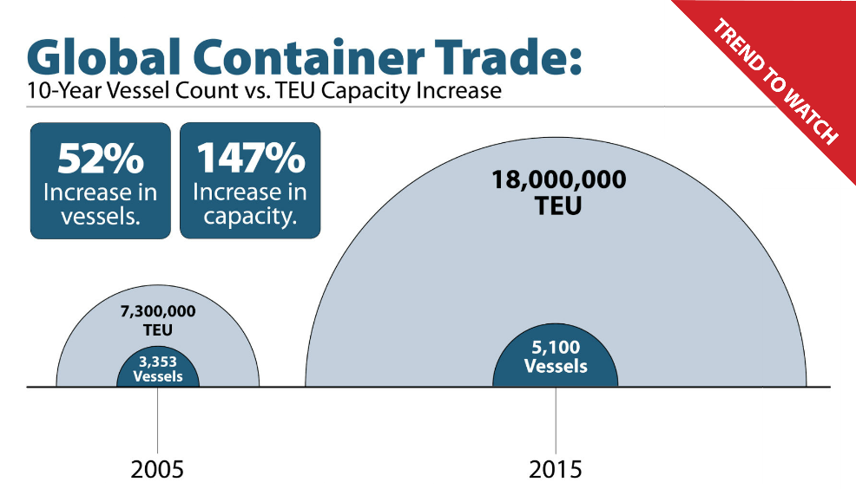

Slide 8
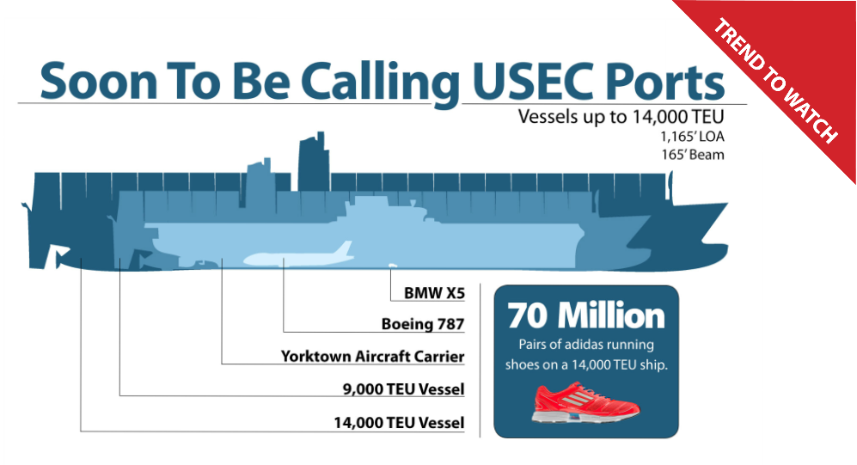

Slide 14
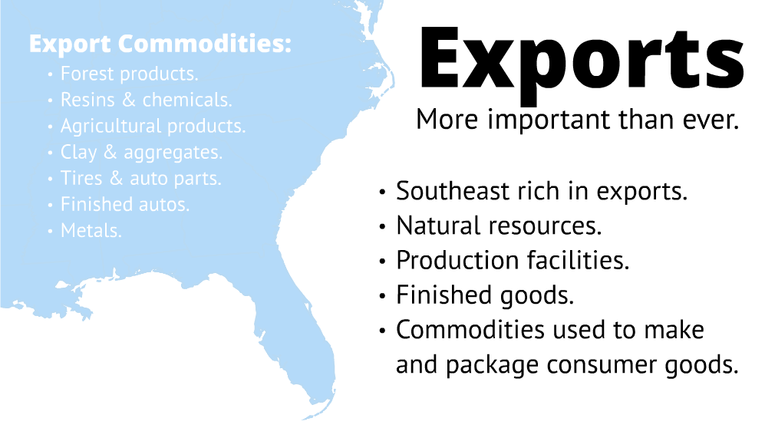

Slide 15
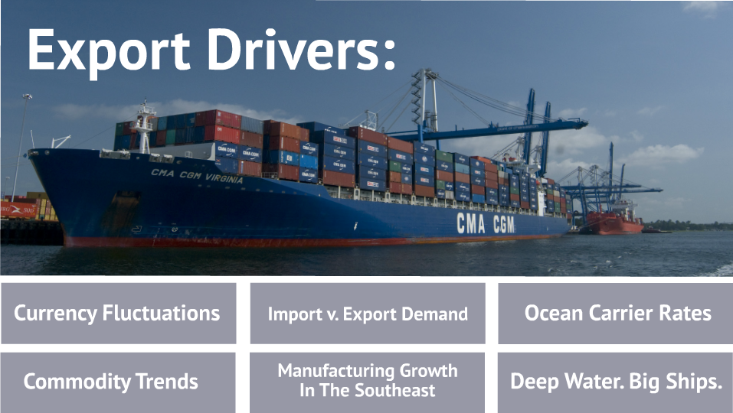
SCSPA Top 5 Strategic
Plan Priorities
These are strongly interdependent.

Slide 16
Exported containers through the Port of Charleston
Since January 2009, exports have grown 36%.

Slide 17
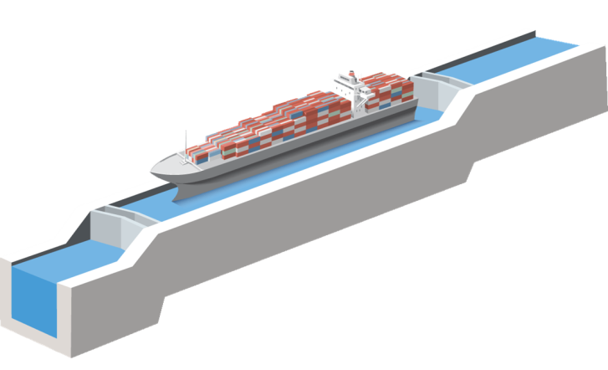
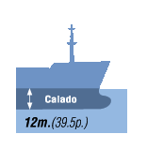
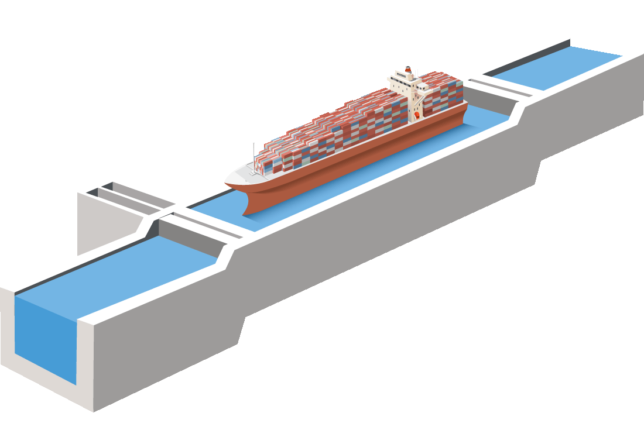
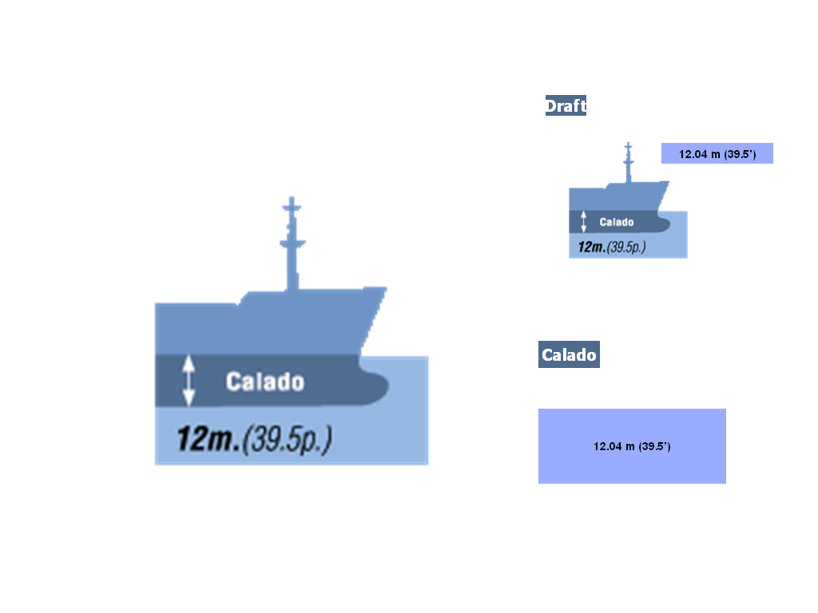
Panama Canal is a Game Changer for the Port Industry
33.5m (110’)
Current Locks
Vessel Max: 4,800 TEUs
294.1m (965’)
32.3m (106’)
Draft
12.04 m (39.5’)
366m (1200’)
304.8m (1000’)
49m (160’)
12.8m (42’)
Draft
15.2 m (50’)
55m (180’)
427m (1400’)
18.3m (60’)
New Locks
Vessel Max: 12,600 TEUs
*Courtesy of Panama Canal Authority
17
Notes:
17

Slide 18
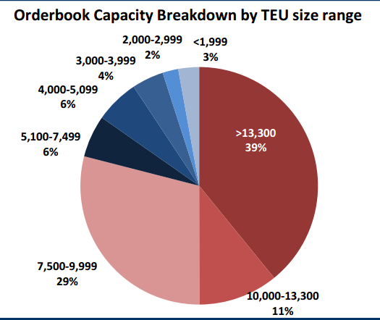
85%
of ship capacity on order is for post-Panamax ships.
Source: Alphaliner November 2013
18

Slide 19
Results of Operations
For Period Ending March 31, 2014
19

Slide 20
Pier Container Volumes – FY2010 thru FY2014 (FYTD - March)
FY2014 volumes are over FY2013 by 4.7%.
20

Slide 21
Charleston Harbor
Post 45 Deepening
Feasibility Study

Slide 22



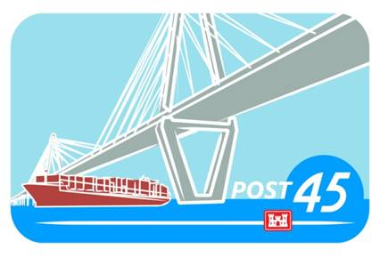
This summer’s most anticipated blockbuster…
Post 45
Draft Feasibility Report and EIS
Exclusive public showing at Mark Clark Hall on The Citadel’s Mark Clark Auditorium

Slide 23

Trailer
Study is currently
on SCHEDULE and
WITHIN BUDGET

Slide 24
Trailer
PDT is working long hours analyzing the data and drafting
the report

Slide 25
Trailer
Partnerships have been the key to continued progress

Slide 26









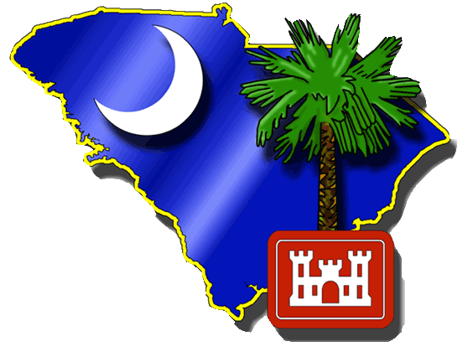
Starring
State Agencies
Non-Federal Sponsor
Stakeholders
Federal Agencies
…and many others!

Slide 27

Leading Roles
Hydraulic
Engineers
Geotechnical
Engineers
Civil
Engineers
Biologists
Contract
Specialist
Program
Analyst
Project Manager

Slide 28
Sneak Preview
Coming this summer…

Slide 29
Story Begins
Problems
Opportunities
Increased operation costs due to light loading and tidal delays
Growth trends in container traffic necessitates navigational improvements
Reduce transportation cost of trade
Reduce operations and maintenance costs for federal channel
Reduce navigation constraints facing harbor pilots
Beneficial use of dredged material
Enhance natural resources in the project area
Preserve cultural/historical resources

Slide 30
Plot Thickens
Preliminary Alternatives
  Deepening channel(s) to a variety of depths, including 50+ feet MLLW,
  Widening channel(s),
  Adjusting existing channel alignments/bend easing, and
  Widening and/or lengthening turning basins.
Refined Alternatives
  Channel segments to Wando & Navy Base terminals undergoing detailed analyses at 48, 50, and 52-ft (MLLW)
  Channel segments from Navy Base to N Charleston terminal undergoing detailed analyses at 47 and 48-ft (MLLW)
  Turning basins and channel widening alternatives developed in concert with harbor and tug pilots

Slide 31
Plot Twists
& Turns
Three Es of the Project:
Engineering
Environmental
Economics

Slide 32
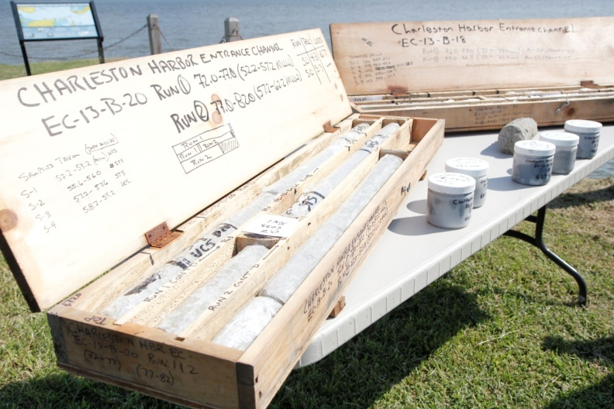
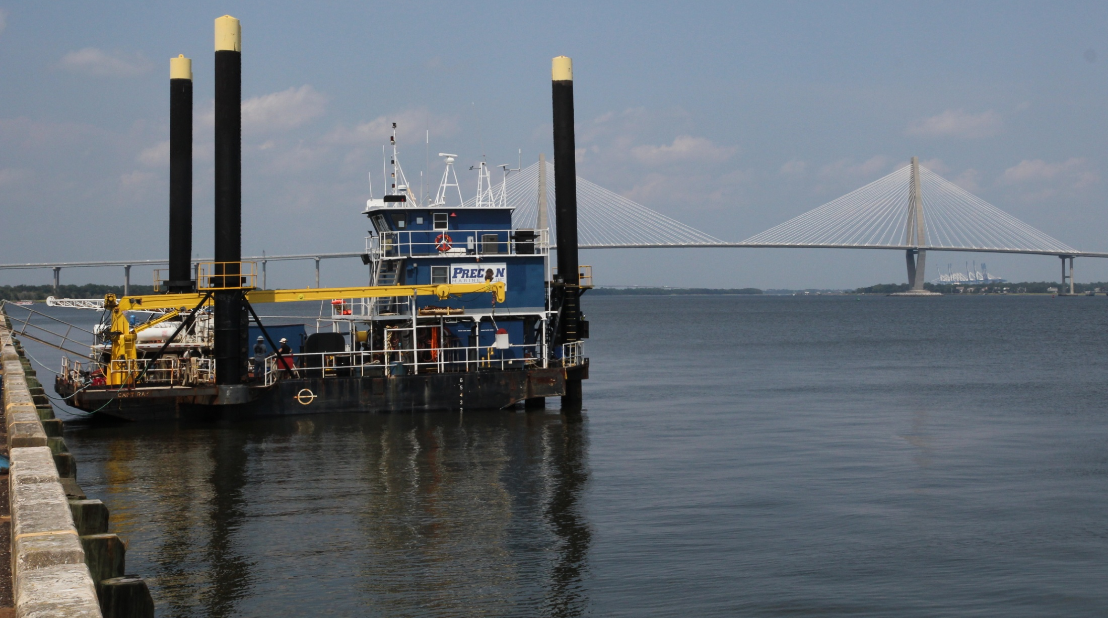
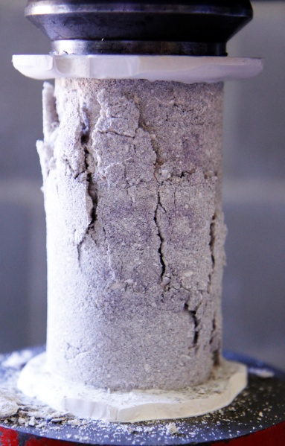
Complexities
Plot Twists
& Turns
Type of dredge, quantity of rock, cost estimates, impacts to hardbottom, mitigation requirements, material for mitigation project…

Slide 33
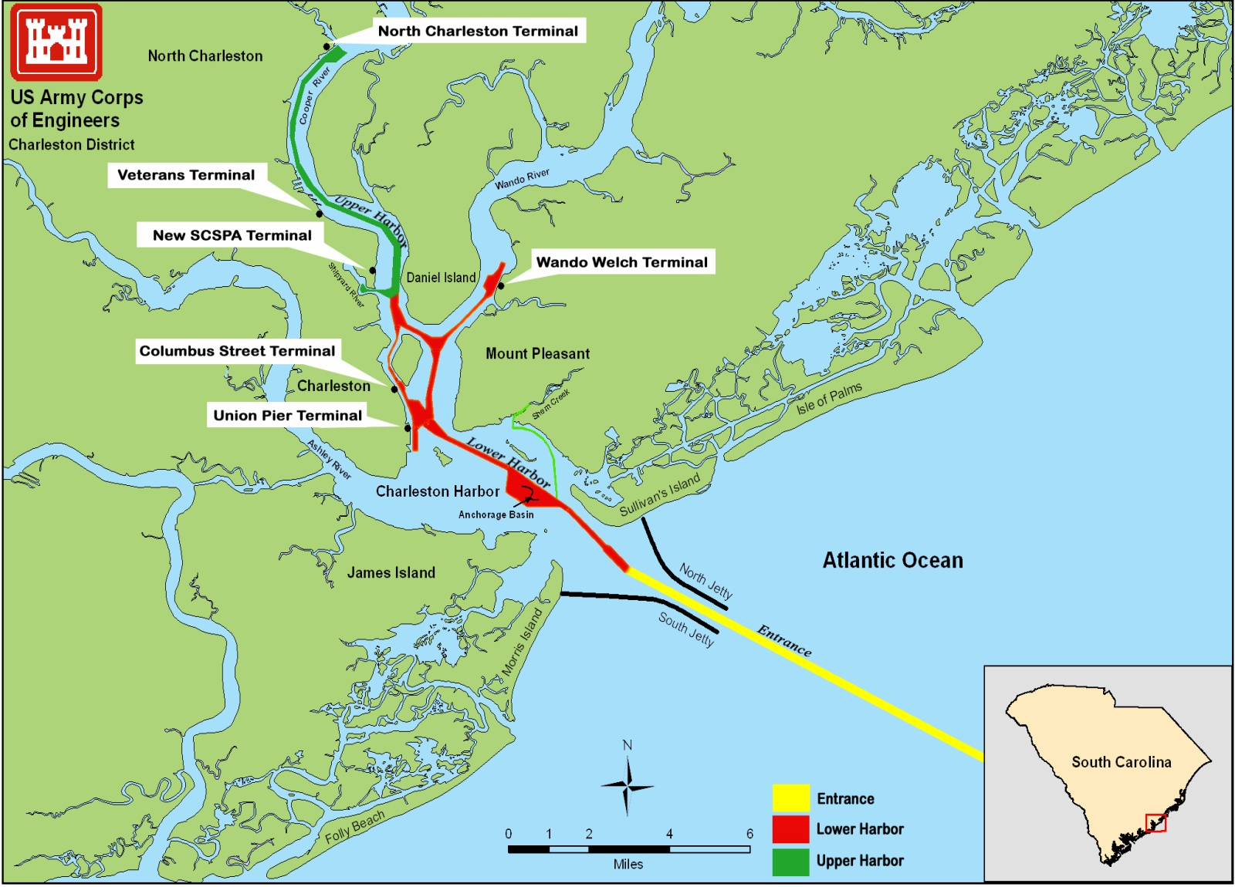
Complexities
Unexpected
Information Is Revealed
11%

Slide 34
Sequels
Stay Tuned…

Slide 35
Sequels
FEIS & Final Report Complete
Spring 2015
Final Chief’s Report
September 2015
Preconstruction Engineering and Design (PED) Phase
Authorization and Appropriation for Construction
Construction

Slide 36
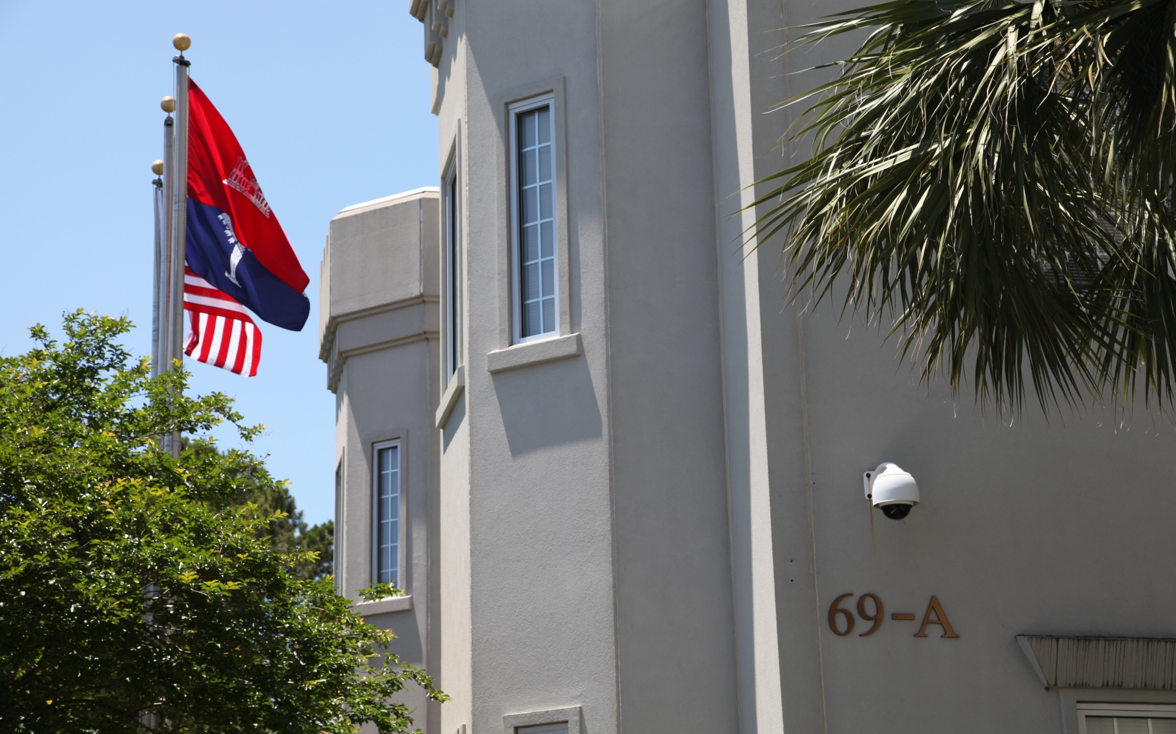



Thank You!
www.sac.usace.army.mil
twitter.com/CharlestonCorps
www.facebook.com/CharlestonCorps
BUILDING STRONG®

Slide 37

Questions?
Questions?

